Slide 1

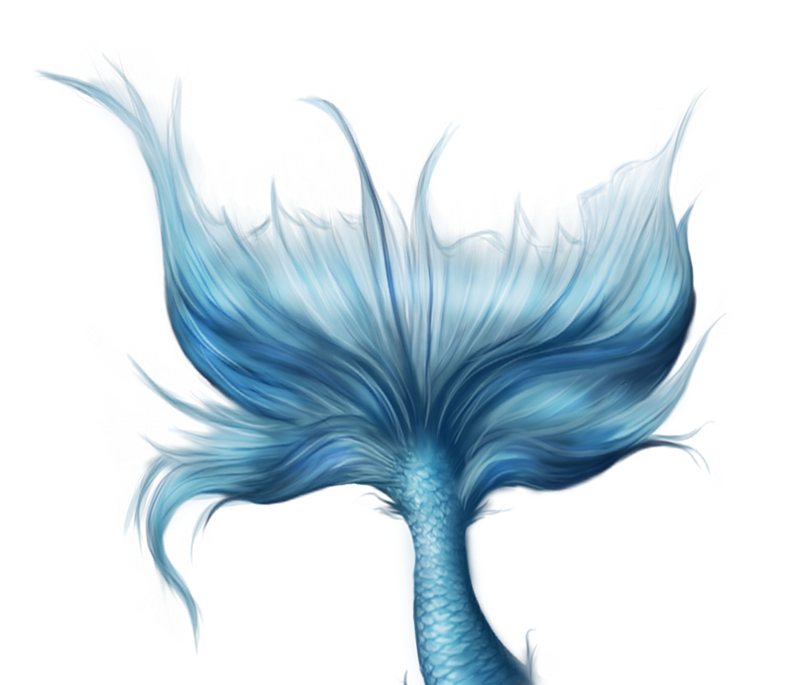

Flowers
Classification
Foundation of Deep Learning
Anno accademico 2021/2022
Simone Poggi, Emilio Lingenthal, Michele Bonera
846652 889111 890256

Slide 2
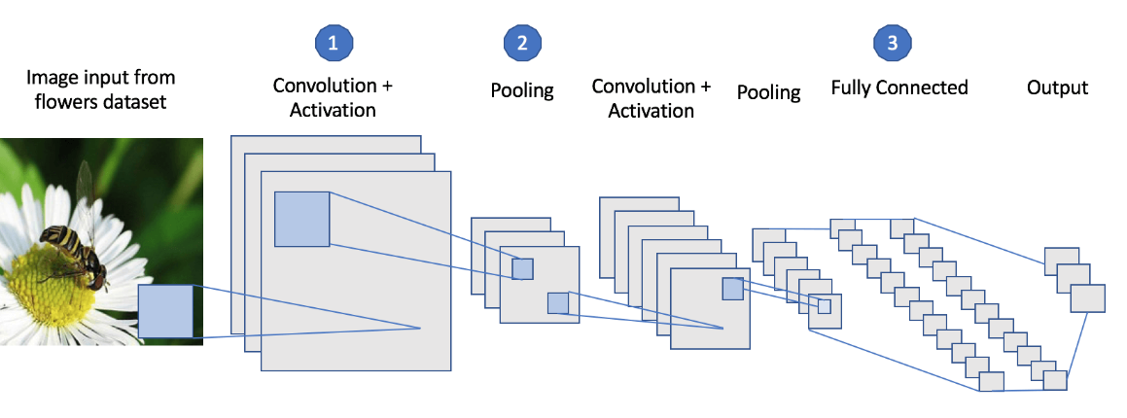
Introduction
The aim of the project is to develop a model that is able to classify species of flower from a set of images.
In order to do it, we implemented a Current Neural Network (CNN) that will be explained in the following slides

Slide 3





Dataset
The dataset contains 3670 images belonging to 5 different species of flowers:
daisy
dandelion
roses
sunflowers
tulips

Slide 4


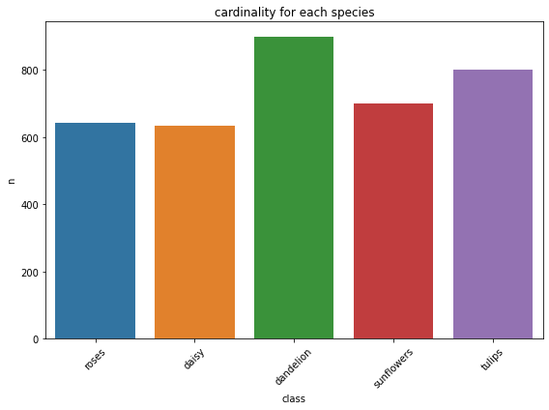
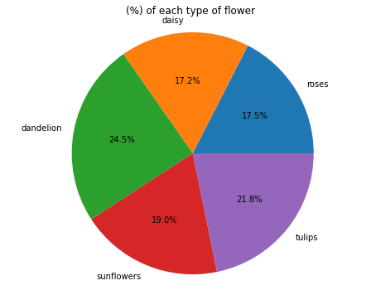
Descriptive Analysis
The analysis point out the existence of balance between the cardinality of the classes.
This means that in every class there is almost the same amount of images

Slide 5
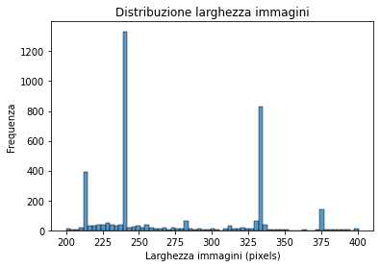
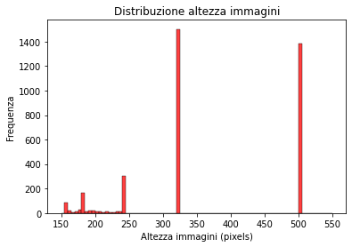
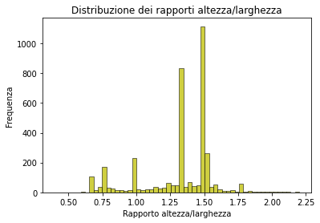
To decide which image format to adopt, we analyzed the distributions of width, height, and their ratio,
as well as their average values, concluding that the most suitable format (i.e., the one that changes the images as little as possible overall) is 240x320 (which has a height/width ratio of 1.33)
Average height = 271.8
Average width = 365.1
Average height/width ratio = 1.33

Slide 6
Decision workflow
Image size
Batch size
Early Stopping
Activation function
Batch normalization
Conv2D layers (32,64,128) filters 3x3
MaxPooling with 3x3 windows and strides = 3
Optimizer function
Loss function

Slide 7
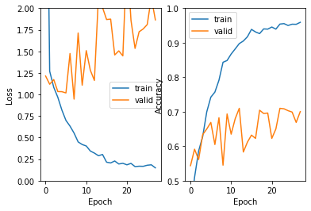
1st Architecture
This architecture consist of the following layers:
3 Convolutional Layers (32,64,128 filter with 3x3 dimensions)
3 Relu Activation functions
2 Max Pooling (3x3, strides = 3, padding = “same”)
1 Global Max Pooling
1 Dense Layer (5 classes, activation = “softmax”)
As loss function and optimizers were used categorical_crossentropy
and RMSprop with a learning rate equal to 0,001

Slide 8
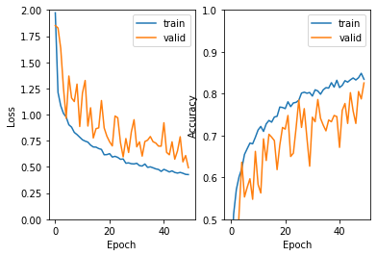
2nd Architecture
This model was developed implementing BatchNormalization, Dropout (with rate = 0.5) and Flatten layers on the previous architecture.
The Dropout layer randomly sets input units to 0 with a pre-set frequency at each step during the training time.
The Flatten layer reshape the tensor removing all the dimension except for one.
As we can see from the graph the addition of these layers reduced overfitting.

Slide 9
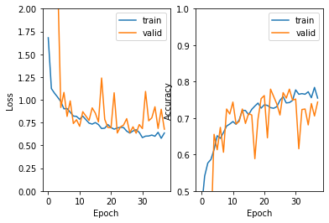
3rd Architecture
This architecture introduced LeakyReLU as activation function, in order to prevent the problem of vanishing gradient.
The chosen optimization algorithm for the model was Adams with a learning rate equals to 0.005. Adams is used to update network weights iterative based in training data.
We’ve also introduced here data augmentation: in each epoch every image is substituted by a geometric transformation of it (based on horizontal flip, zoom and rotation). The goal of this process is to have more training variety, which helps reduce overfitting.

Slide 10
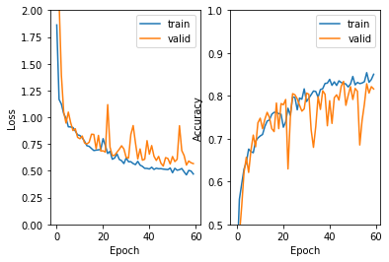
4th Architecture
The last architecture introduce the parameter kernel_initializer to
the convolutional and the dense layer and the kernel_regularizer
parameter to the Dense layer. We also increased the number of
epochs from 50 to 60.
The first parameter define the way to set the initial random weight of the layer while the second one apply penalties on layer parameters
or layer activity during optimization.
Hyperparameter tuning: batch size
In this architecture it’s been decided use the GridSearch algorithm (with cross validation) to pick (with a limited amount of bias thanks to the training set split that the algorithm performs) the best value (the one that leads to better performances) of the parameter ‘batch size’ between 16, 32 and 64. The algorithm was allowed to choose between three sizes and we set the number of epochs to only 10 because it is very computationally demanding. Turns out that the optimal batch size for this architecture is 64.

Slide 11
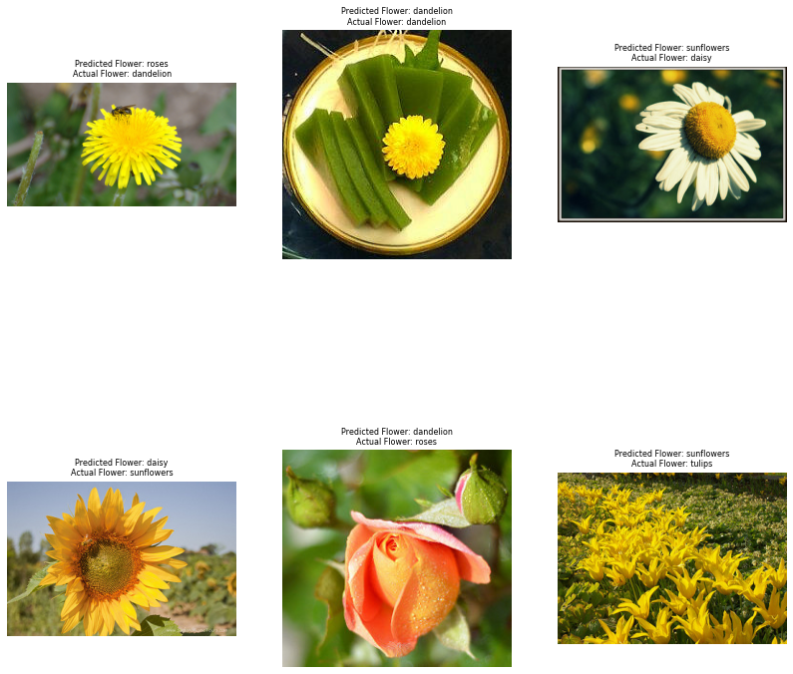
Results

Slide 12
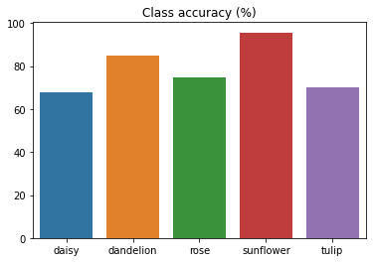
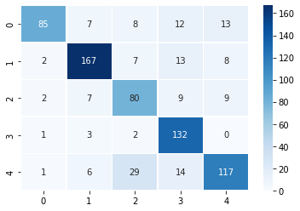
Accuracy of the prediction
Once the confusion matrix has been obtained we wanted to see which class is predicted with the higher accuracy.
In order to do it we computed, for each class, the ratio between the total number of record predicted correctly and the total number of record. After doing that it was clear that the class predicted with an higher level of accuracy is “sunflower”.

Slide 13

New image classification
To test the model a new image was taken from Google in order to know if the neural network manages to classify it.
This image was well classified by the model, indeed it labeled correctly Sunflowers

Slide 14
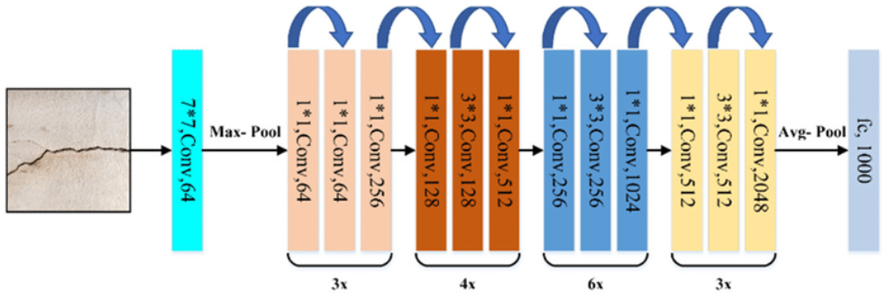
Transfer Learning
This method take a model trained on a large dataset and transfer its knowledge to a smaller dataset.
In other words, we use the patterns that the Neural Network found to be useful to classify images of a given problem to classify a completely different problem without retraining that part of the network.
We will apply a famous convolutional neural network called ResNet50 on the data:
This model achieves 92.5% top-5 accuracy in ImageNet, which is a dataset with over 14 million of images belonging to 1000 classes

Slide 15
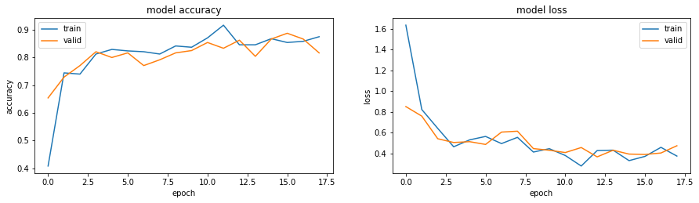
Using a pre-trained model such as ResNet50 can improve the model’s accuracy. We can notice that this model has an higher accuracy than the model build from the scratch.
Indeed, Transfer Learning helps to achieve great results with less expensive computation.

Slide 16

Conclusions
The choice in terms of layers and their parameters matched with the implemented techniques and also it has satisfied our research aims, not only in terms of accuracy but especially in terms of optimization of net structure.
Since the dataset has a low dimensionality, despite data augmentation techniques were implemented , it was not possible to reach an accuracy value higher than 85%.
In conclusion, surely the model can be upgraded choosing other techniques or parameters to optimize the performance: the comparison with the pre-trained models shows that there is a margin of improvement of the model build from scratch.

Slide 17
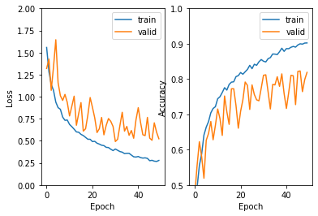
Failed attempt 1
In this attempt, the architecture present an additional convolutional layer with 256 filters.
As we can see the result is not satisfactory as the
overfitting is high

Slide 18
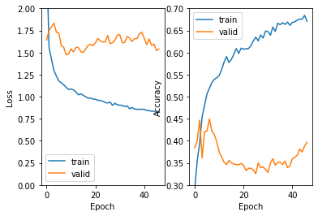
Failed attempt 2
Using the optimizer RMSprop with a learning rate equal to 0.001 and “relu” as activation function the model features a high overfitting

Slide 19
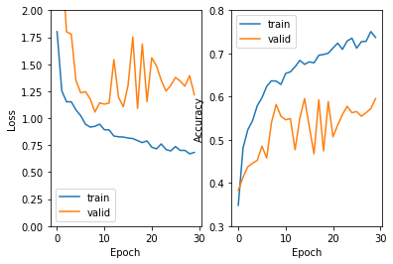
Failed attempt 3
Test on the second architecture with a higher batch size (256)
This choice was not appropriate due to data dimensionality
and model architecture.

Slide 20
THANKS!

